Slide 1


COS 60011 –Technology Design Project Deliverable – 3 Project presentation and demo
AI Car Purchase Recommendation System

Slide 2
Team Members and contribution statements
Arun Ragavendhar Arunachalam Palaniyappan - ( 104837257 ) - Group leader
Lead Software Developer , Researcher ,Machine Learning Engineer, Data Engineer
Created datasets , designed and developed the Neural network model and Streamlit web application.
Gurlivleen Singh Kainth - ( 104796002 )
Data Engineer
Contributed to dataset creation , cleaning and preparation for model training
Amirajsinh Pradhyumansinh Sonagara - ( 104801333 )
Web Developer
Contributed to Stream Web Application Development
Henil Mukeshbhai Pistolwala - ( 105065800 )
Web Developer
Contributed to Stream Web Application Development

Slide 3
Presentation agenda and content
Background and Purpose of the Project
Components of the Project
Design, Development, Implementation and testing of the Components
Integration of the Components
Challenges and issues faced and how it was fixed
Improvements made on feedback received
Final Product testing and usage
Future scope and plans for Expansion
Conclusion
References

Slide 4

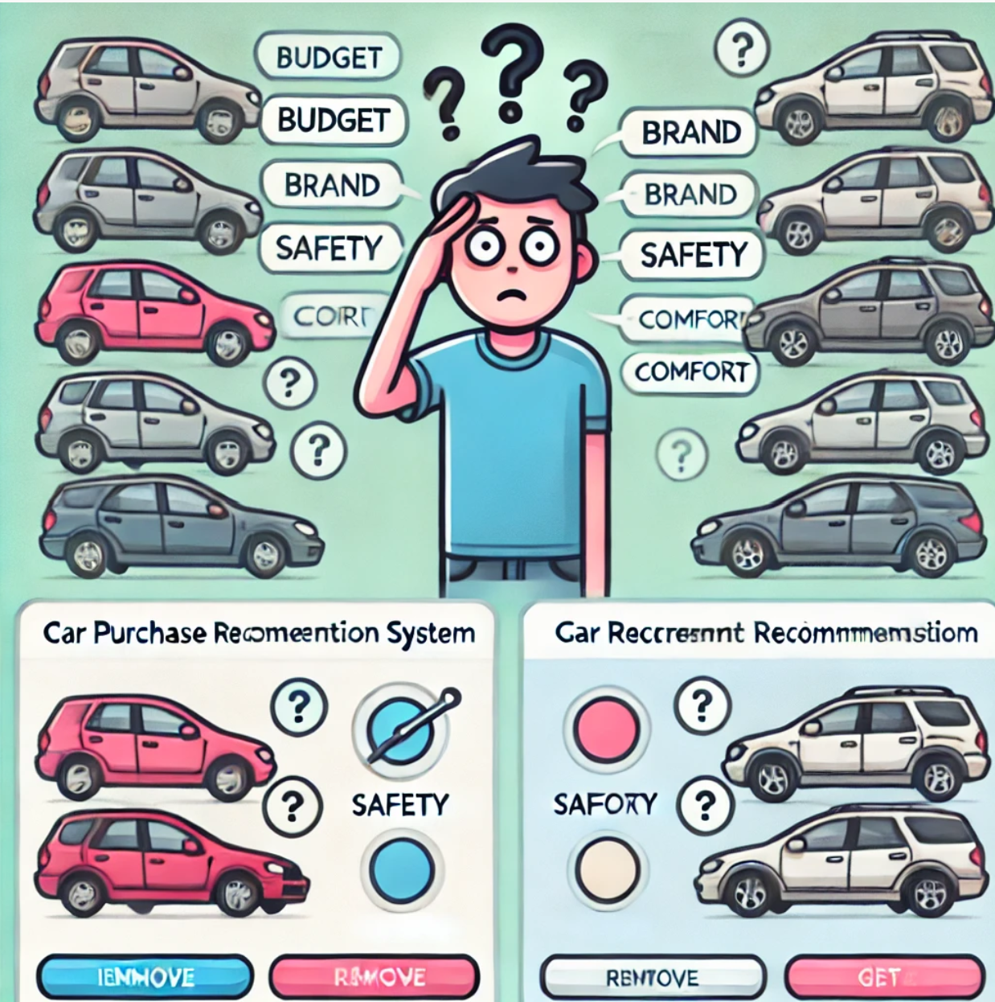
Background and Purpose of the Project
Need for a Car Recommendation System
Choosing the right car has become more complex with so many options and features to consider, like budget, brand, safety, and comfort.
This can make the decision-making process overwhelming for buyers.
The goal of this project was to create an AI-powered Car Purchase Recommendation System that simplified this process by offering personalized car suggestions, helping users save time and make confident choices.

Slide 5
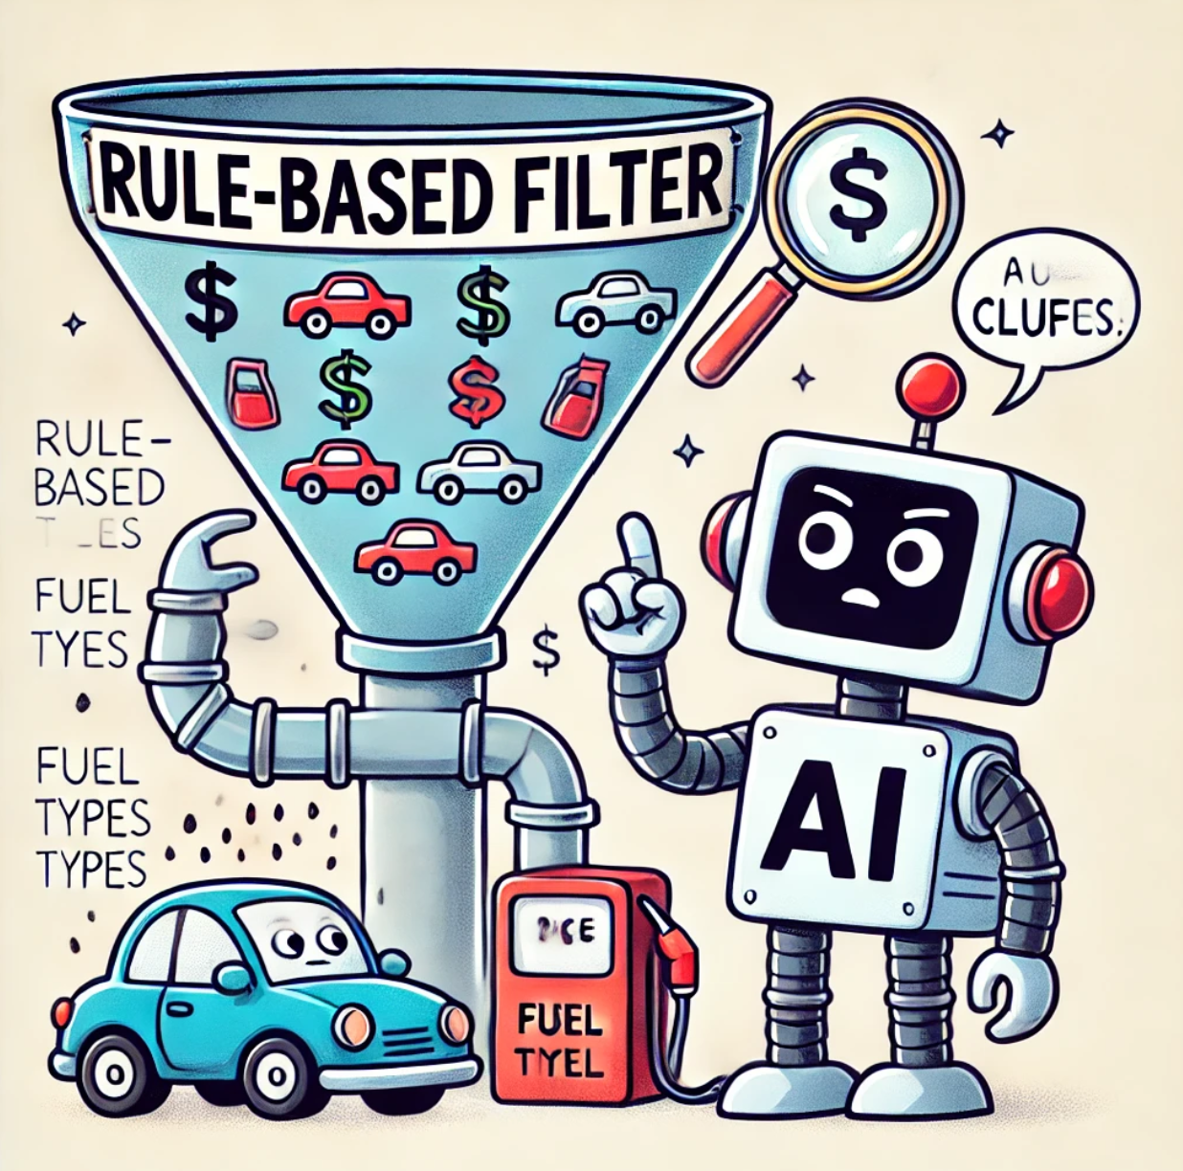
Existing Car Recommendation systems in the Market and their limitations
Most car recommendation sites, like CarWow, Cars24.com, and Autocar.com, use basic SQL filters or simple algorithms like cosine similarity to suggest cars for buyers.
These methods follow pre-set rules, such as filtering by price or fuel type, without adapting to individual user preferences.
As a result, they don’t truly learn or make intelligent decisions.
Here, a buy never gets a personalized recommendation based on their unique preferences and niche requirements.

Slide 6

Advantages of a Neural Network based Recommendation system
Unlike traditional car recommendation platforms, this system employs an advanced Multi-Layer Perceptron (MLP) neural network integrated with an interactive web application.
This approach not only boosts user engagement but also offers personalized recommendations in real-time based on each user’s specific needs and preferences.
By analyzing complex inputs, the system simplifies the car selection process, making it faster, easier, and more tailored to individual users.

Slide 7



Components of the system
The AI Car Purchase Recommendation System mainly has 3 main components :
The Front End Web Application built using Streamlit
The Neural network model built using Tensorflow
The dataset (cleaned and prepared) to train the model

Slide 8

Front end WEB APPLICATION
Engaging and Intuitive Interface with Image-Based Options
Streamlit is an advanced and powerful python library for Web Application development.
The AI Car Purchase Recommendation System leverages Streamlit’s capabilities to create an interactive, visually appealing web app.
Instead of relying on traditional dropdown menus or sliders, the application uses clickable buttons, each accompanied by an image to represent the available options.
This approach ensures that users can easily understand and select their preferences with a single click.

Slide 9

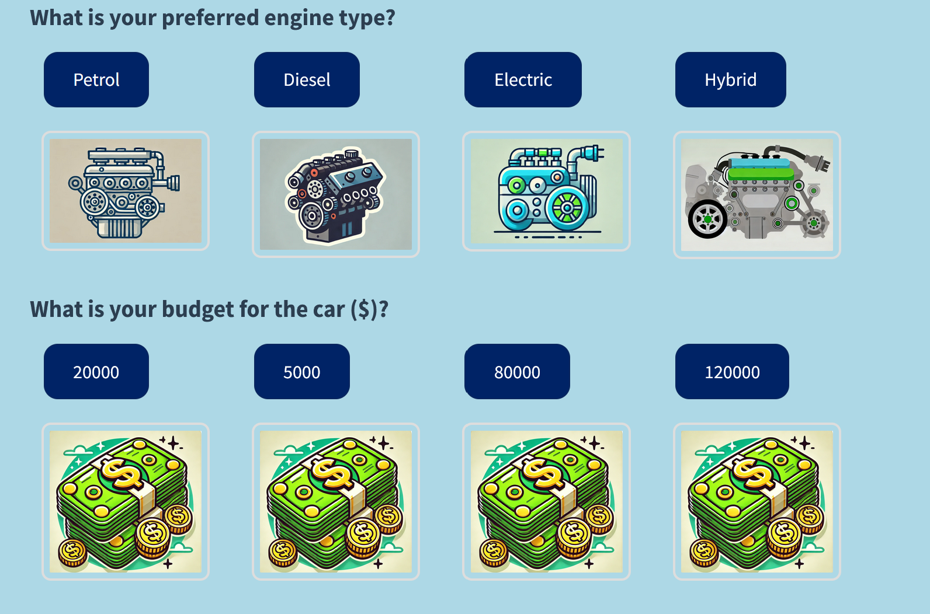
Detailed Breakdown of Pages and Questions
Page 1 (Questions 1-4):
Users are asked about their preferred car body type, engine type, budget, and year of manufacture. Each question displays four clickable image options, clearly labeled and accompanied by intuitive graphics.

Slide 10
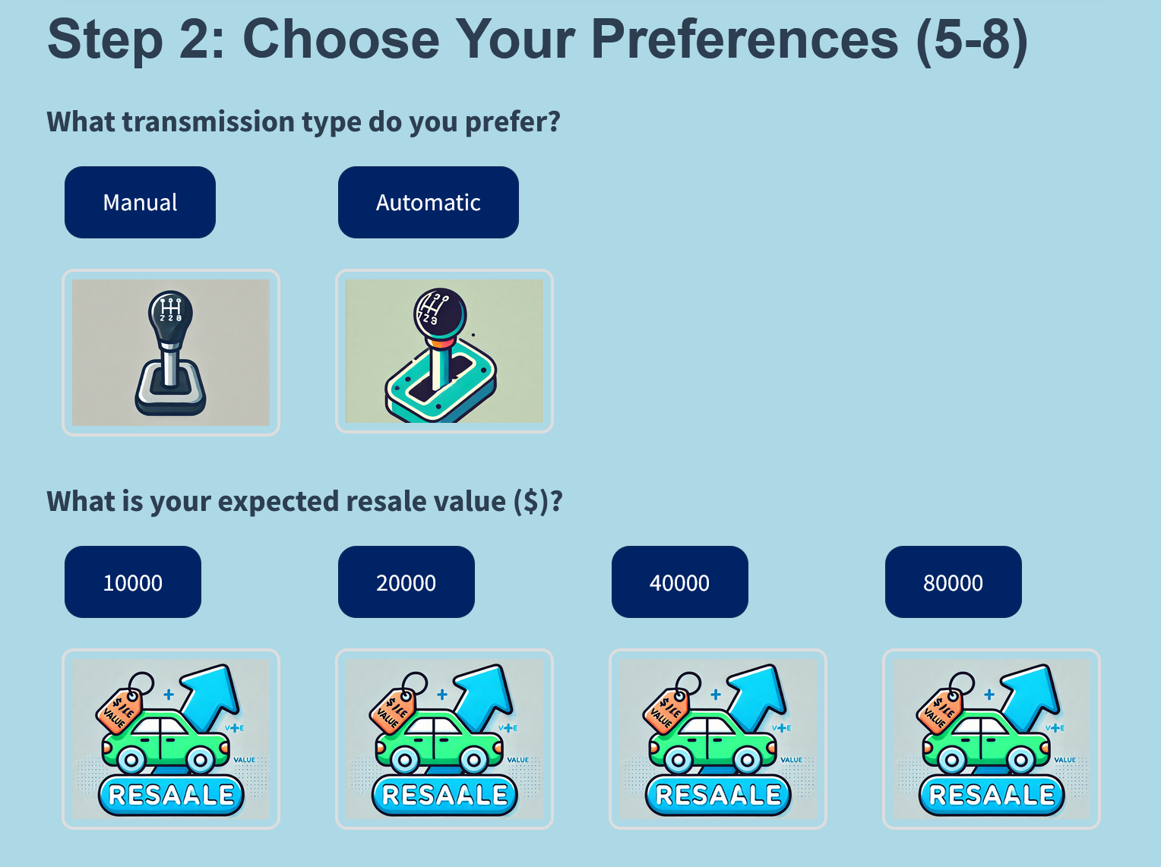
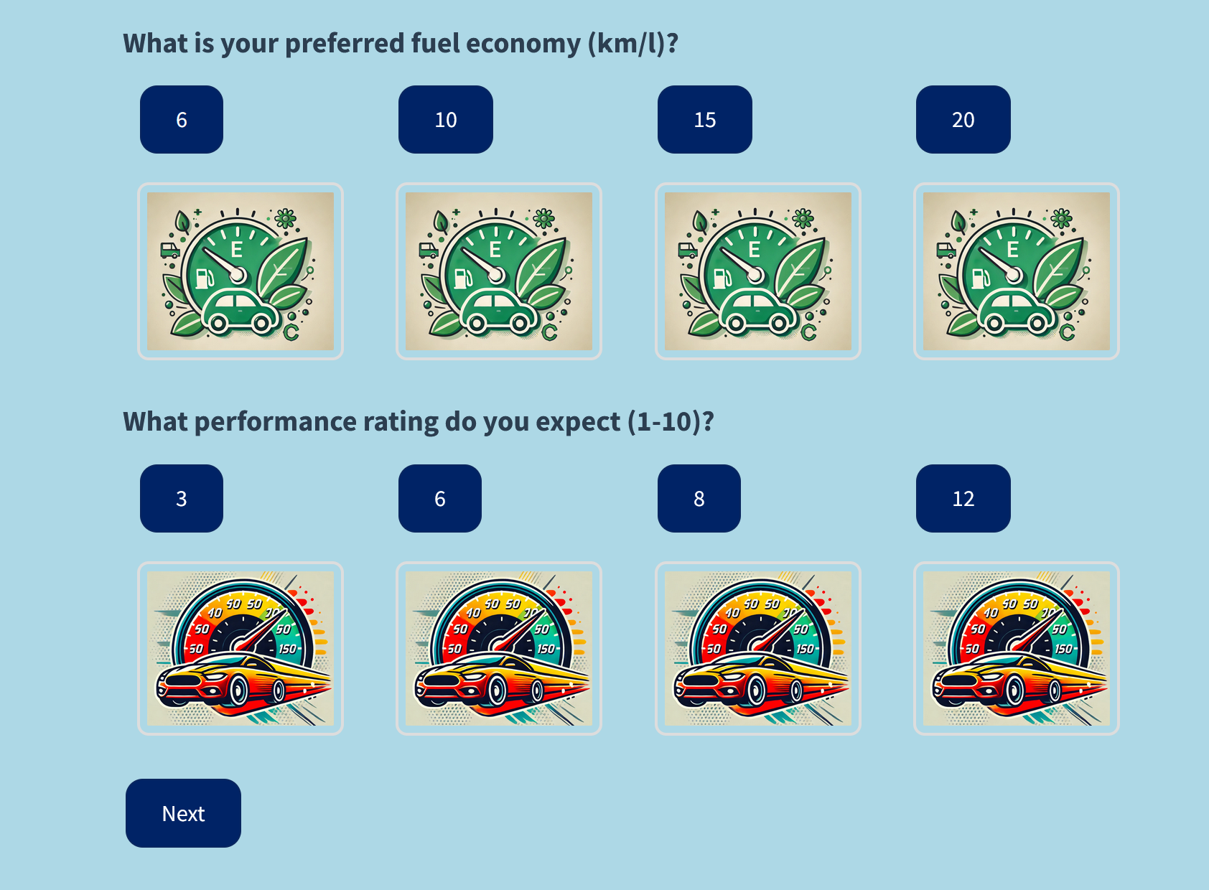
Page 2 (Questions 5-8):
Users are prompted to select their preferred transmission type, expected resale value, desired fuel economy, and preferred performance rating. As before, each option is visually represented, making the selection process both engaging and clear.

Slide 11
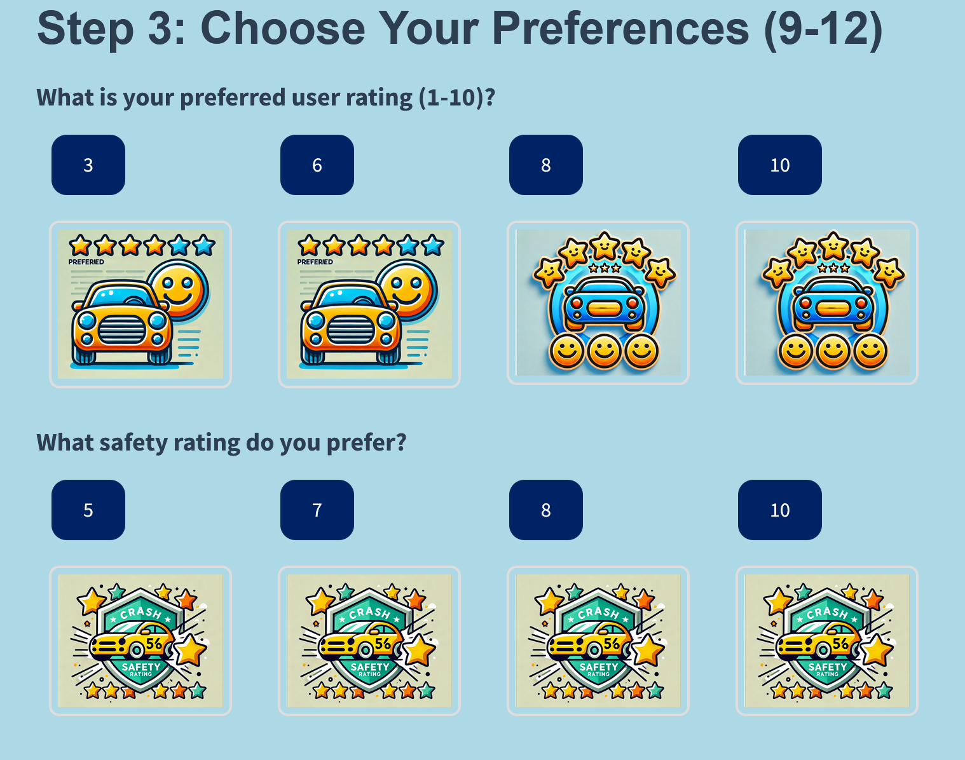
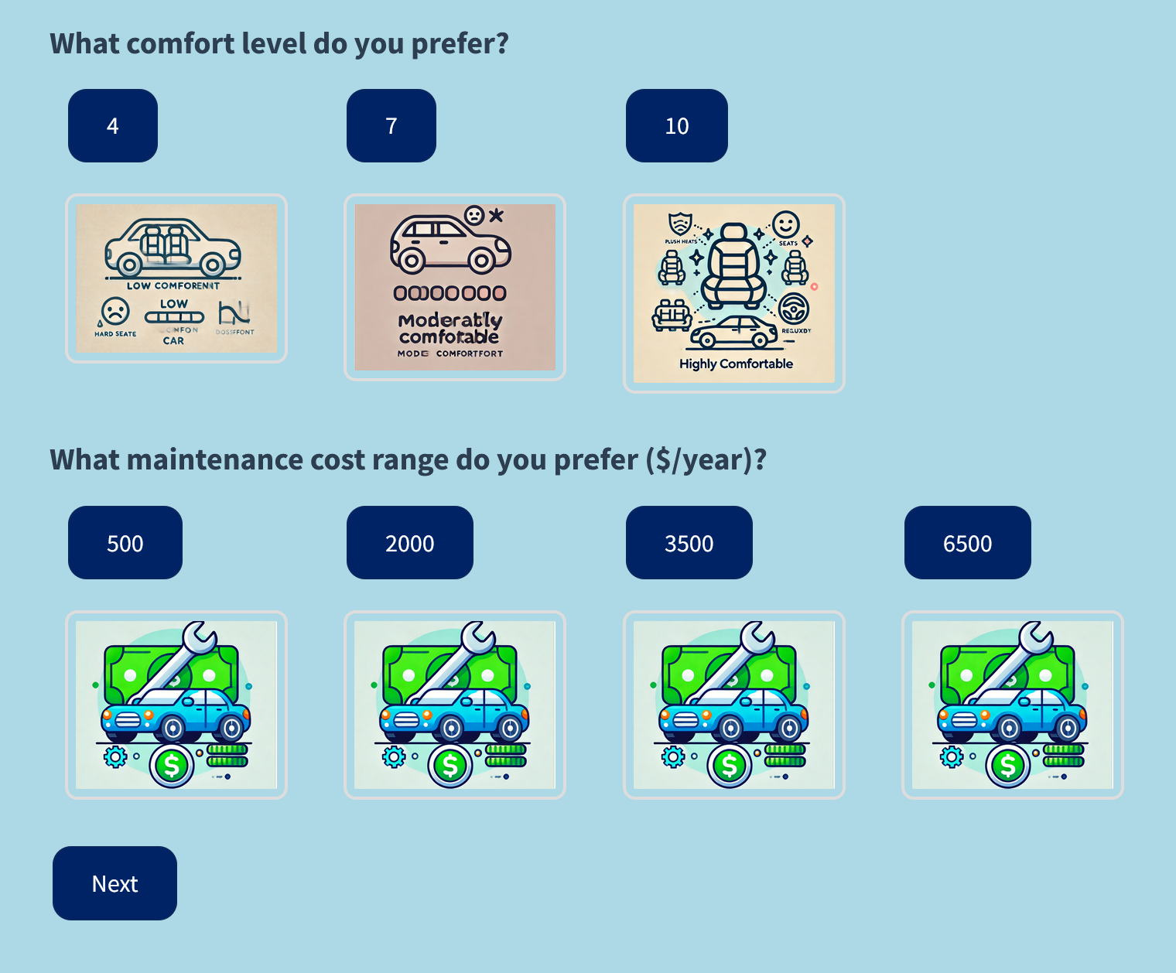
Page 3 (Questions 9-12):
Users are guided through choosing their preferred user rating, safety rating, desired comfort level, and acceptable maintenance cost. The graphical representation of each option allows users to make informed choices effortlessly.

Slide 12
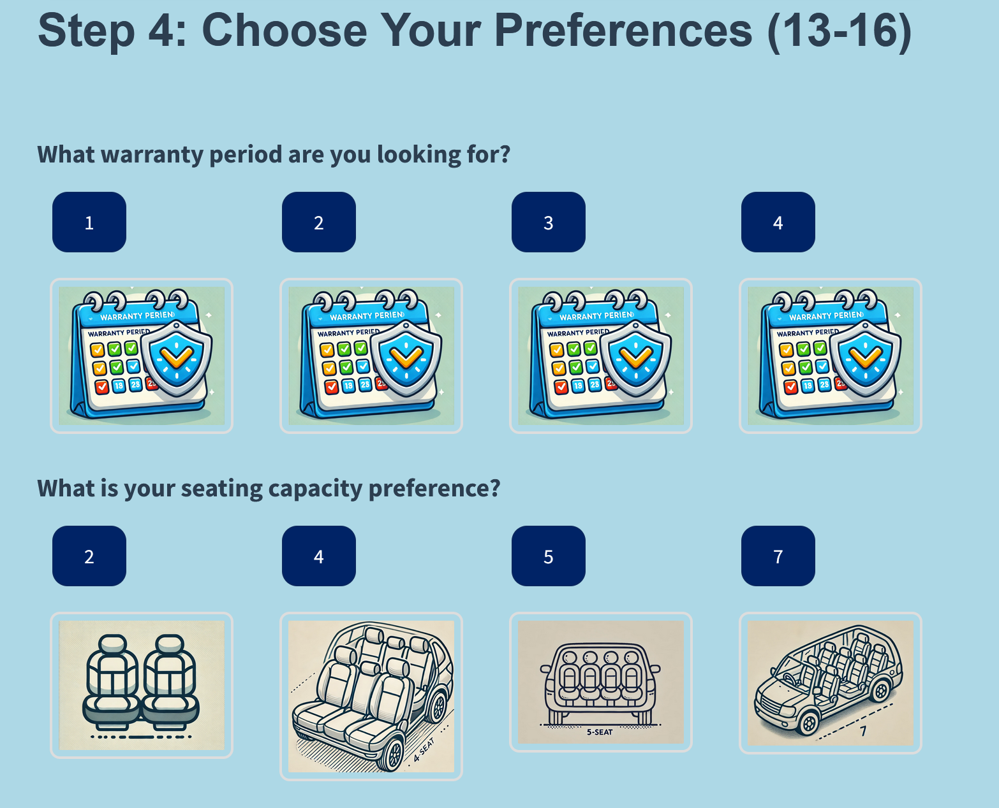
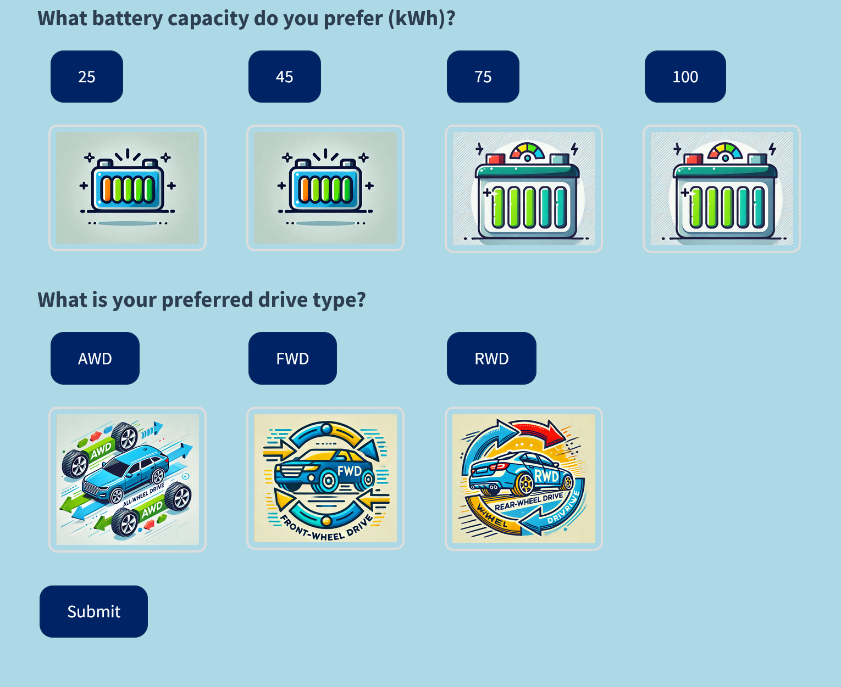
Page 4 (Questions 13-16):
The final page asks users about their preferred warranty period, seating capacity, battery capacity (if relevant), and drive type. Once all selections are made, users are presented with a “Submit” button to finalize their responses.

Slide 13
Collecting and Preparing User Responses for Model Input
After the user completes all four pages and presses the ‘SUBMIT’ the app collects the chosen options and stores them in an array.
Numerical inputs (like budget and fuel economy) are normalized using a technique called Min-Max Scaling, which scales all numbers between 0 and 1.
This prevents any single feature from disproportionately influencing the model.
Categorical responses (like body type and engine type) are transformed using One-Hot Encoding to match the input format expected by the neural network.
This encoding converts categorical options into binary vectors (e.g., [1, 0, 0, 0] for a “Sedan” in the “Body Type” category).

Slide 14

Personalized Car Recommendation and Confirmation
Once the user responses are processed, the app feeds the data into the trained neural network model.
The model analyzes the inputs and identifies the car that best aligns with the user’s preferences.
The car with the highest prediction probability is presented to the user with a personalized message.
The app displays: “Hi buddy! , here is my personalized recommendation for you ! The most suitable car for you would be: Hyundai Ioniq
This message not only confirms the recommendation but also creates a friendly and engaging experience for the user.

Slide 15
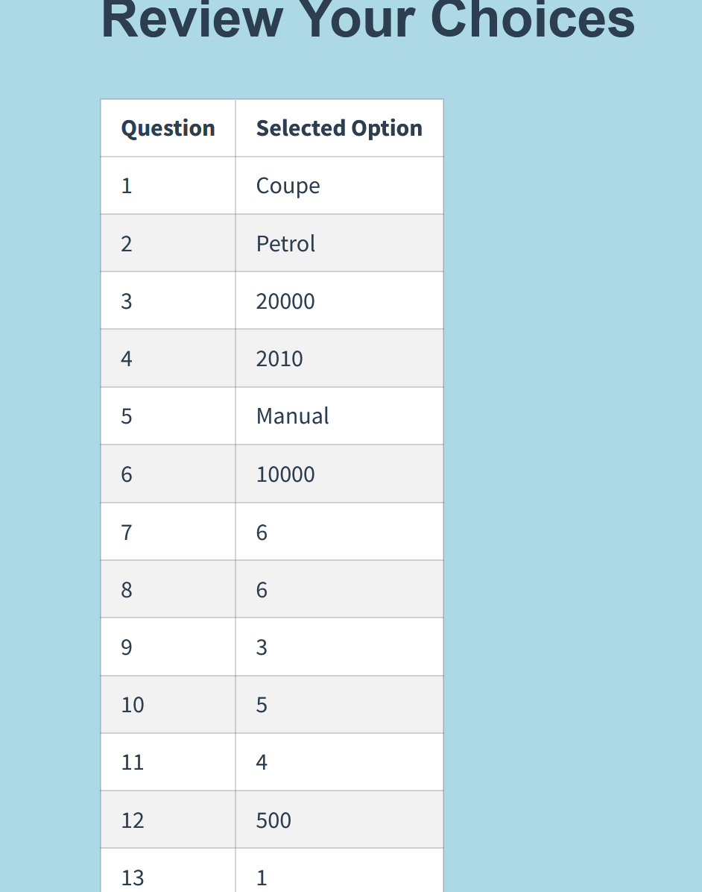
Review and Verification of User Choices
After receiving the car recommendation, if the user clicks “Submit” again, the app redirects them to a review page.
This page presents a detailed summary of the user’s chosen preferences in a neatly formatted table.
Each row in the table corresponds to a question, with the selected option clearly listed beside it.
This layout makes it easy for users to verify their selections before making a final decision.

Slide 16
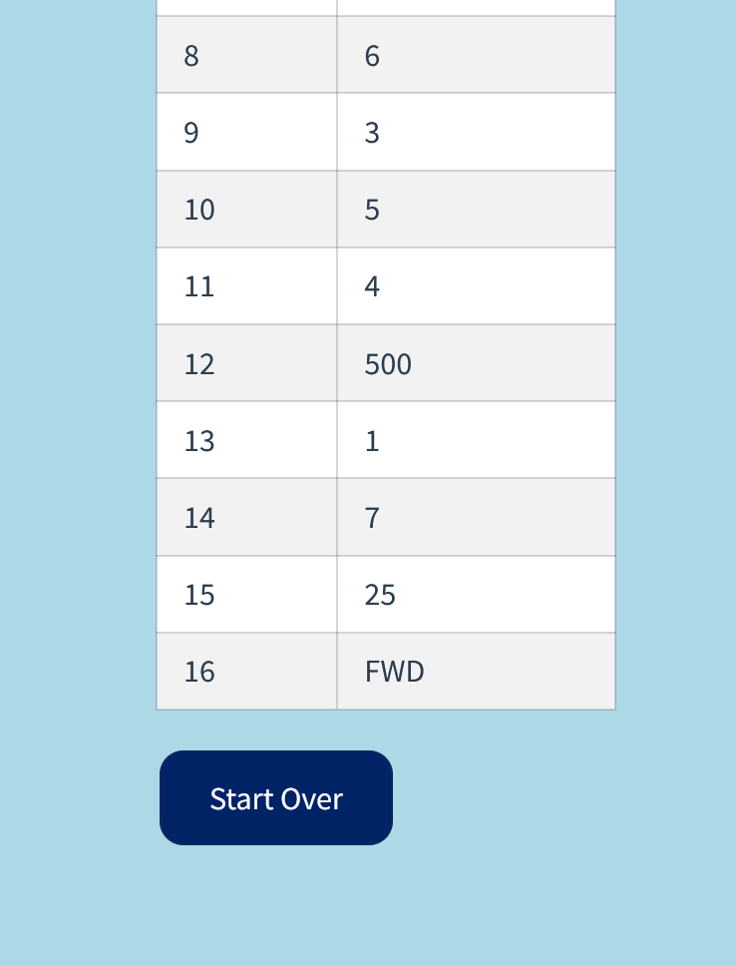
Restarting the System with “Start Over”
On the review page, users are also provided with a “Start Over” button, which allows them to clear all inputs and restart the entire selection process from scratch.
This option gives users the flexibility to refine their choices if needed or explore different combinations to find the most suitable car.

Slide 17

The Dataset
A high-quality dataset is the backbone of any reliable AI model.
For a car recommendation system to make accurate and meaningful predictions, the data it learns from must be comprehensive, clean, and well-prepared.
A thorough research was done about user preferences and car features that make a significant difference to an individual car.
Web scraping was done using BeautifulSoap (a python library ) to gather car data and study car features and corresponding user preferences.
Based on the above , a custom Python script was written to generate a dataset with 10,000 unique records and 18 field attributes to represent the features of a specific car .

Slide 18
Dataset schema
Car ID: A unique identifier for each car record.
Car Name: The make and model of the car.
Body Type: Represents the type of car, such as Sedan, SUV, Hatchback, etc.
Engine Type: Specifies the type of engine used in the car, such as Petrol, Diesel, Electric, or Hybrid.
Price ($): The cost of the car, in USD, to help users filter based on their budget.
Year of Manufacture: Indicates the manufacturing year, providing insights into the car's age and model year.
Transmission Type: Specifies whether the car has an automatic or manual transmission.
Resale Value ($): Indicates the estimated resale value of the car, a key factor for users interested in long-term investment.

Slide 19
Fuel Economy (km/l): Measures the fuel efficiency of the car, often a top priority for cost-conscious buyers.
Performance Rating: A score reflecting the car’s engine power, acceleration, and overall driving experience.
User Rating: A rating based on customer reviews, providing an aggregated score from user experiences.
Safety Rating: Indicates the safety features and crash-test ratings of the car.
Comfort Level: Reflects the car’s interior quality, seating comfort, and ride smoothness.
Maintenance Cost ($/yr): Annual maintenance costs, helping users estimate ongoing expenses.
Warranty Period (years): The number of years covered under the manufacturer’s warranty.
Seating Capacity: The number of seats available, catering to users looking for specific passenger capacities.
Battery Capacity (kWh): Relevant for electric and hybrid cars, indicating the energy storage capacity
of the vehicle’s battery.
Drive Type: Specifies the type of drivetrain, such as Rear-Wheel Drive (RWD), Front-Wheel Drive (FWD),
or All-Wheel Drive (AWD).

Slide 20
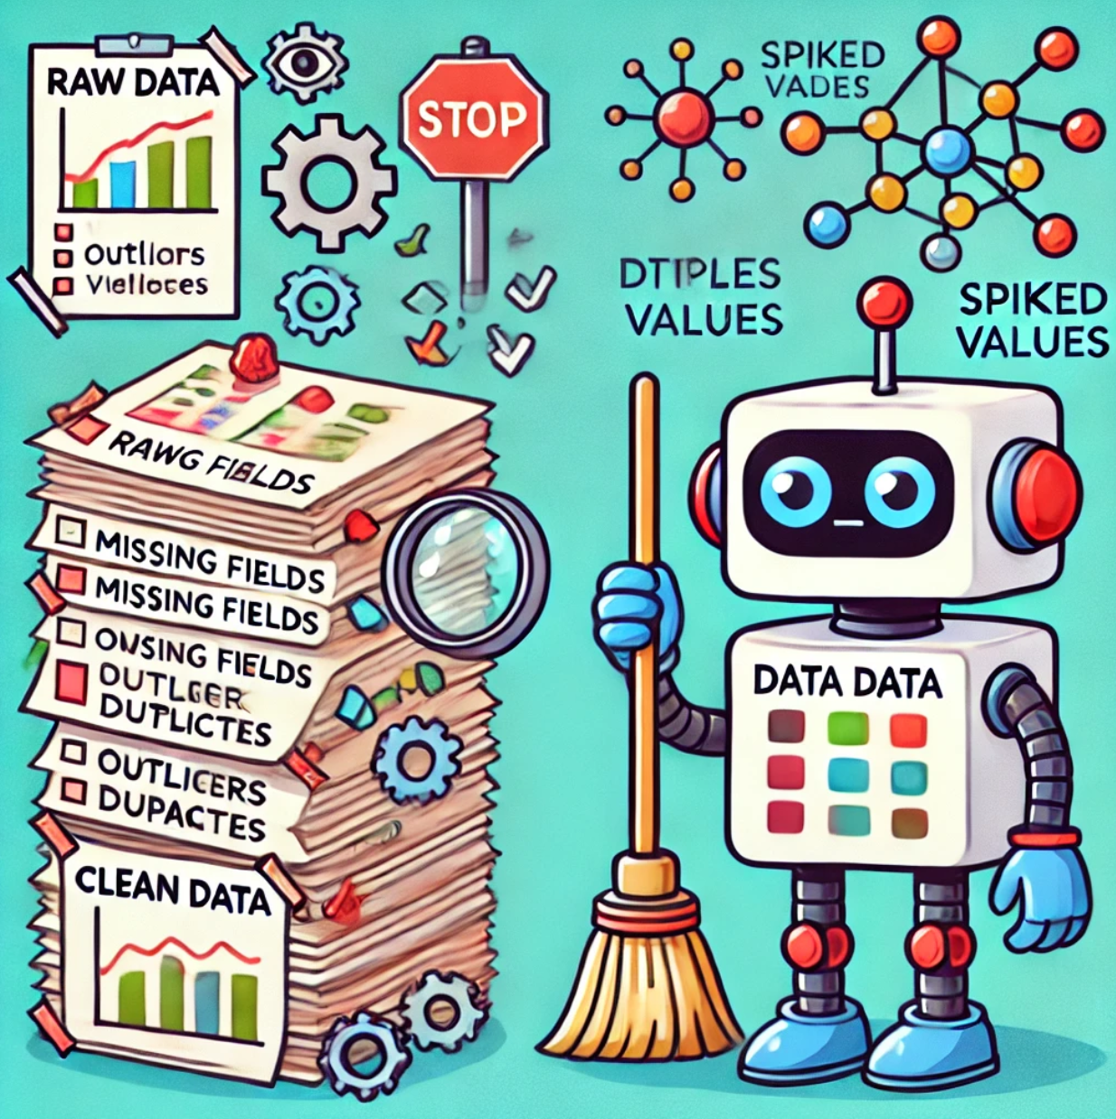
Dataset cleaning and preparation
The raw dataset available now was structured and specific , but , still could not be used to train the model.
It had both numerical and categorical data.
The dataset had string values ( which cannot be sent as input to a node of the neural network ) , missing fields , outlier values , duplicate values and spiked values.
The dataset had to be cleaned , normalized and the categorical string values had to converted to numerical representations before passing them as input to train a neural network .
A custom python script was developed for this to clean , normalize and prepare the raw data.

Slide 21
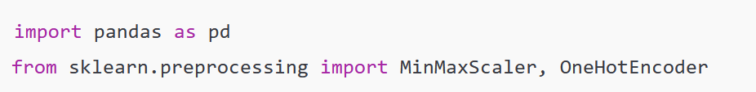
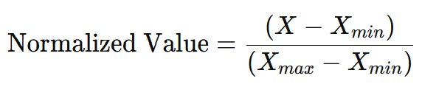
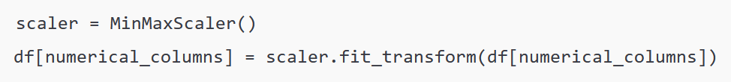
Essential python libraries to perform the Data cleaning and preparation
pandas (imported as pd) library was used for data manipulation and analysis. It provided powerful data structures like DataFrames to store and process datasets.
MinMaxScaler and OneHotEncoder are classes from the scikit-learn library, which helped with data normalization and converting categorical values into a machine-readable format.
Normalizing Numerical Data
The numerical columns where normalized using Min-Max Scaling. This scaled all values between 0 and 1 using the formula:
This transformation ensures that all numerical features have a consistent scale, preventing larger values from disproportionately affecting the model.

Slide 22
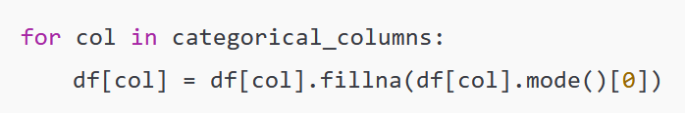
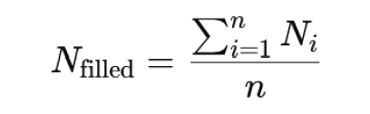
Handling Missing Data
Missing data can lead to skewed results and inaccurate predictions, making it essential to address these gaps.
For categorical columns, missing values were replaced with the most frequent value (or mode). The mode represents the most common category within each column, helping to maintain the column's natural distribution.
Missing numerical values (e.g., price or performance ratings) were filled using the average value of the available data. This method keeps the dataset balanced without biasing towards any entry.

Slide 23
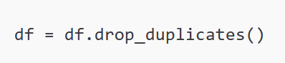
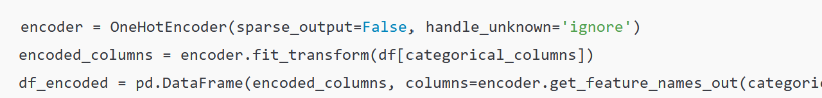
Removing Duplicate Entries
Duplicate records were removed from the dataset. Duplicate entries can distort model training, so it’s essential to eliminate them to maintain data quality.
One-Hot Encoding for Categorical Variables
The above code applies One-Hot Encoding to convert categorical values into binary (0 or 1) representations. For example, if a column 'Engine Type' had values 'Petrol', 'Diesel', and 'Electric', it is transformed into separate columns like ‘Engine Type_Petrol’, ‘Engine Type_Diesel’, and ‘Engine Type_Electric’, with 1 indicating presence and 0 indicating absence.
The fully cleaned and prepared dataset was saved in a new csv file which was sent as input the neural network model.

Slide 24
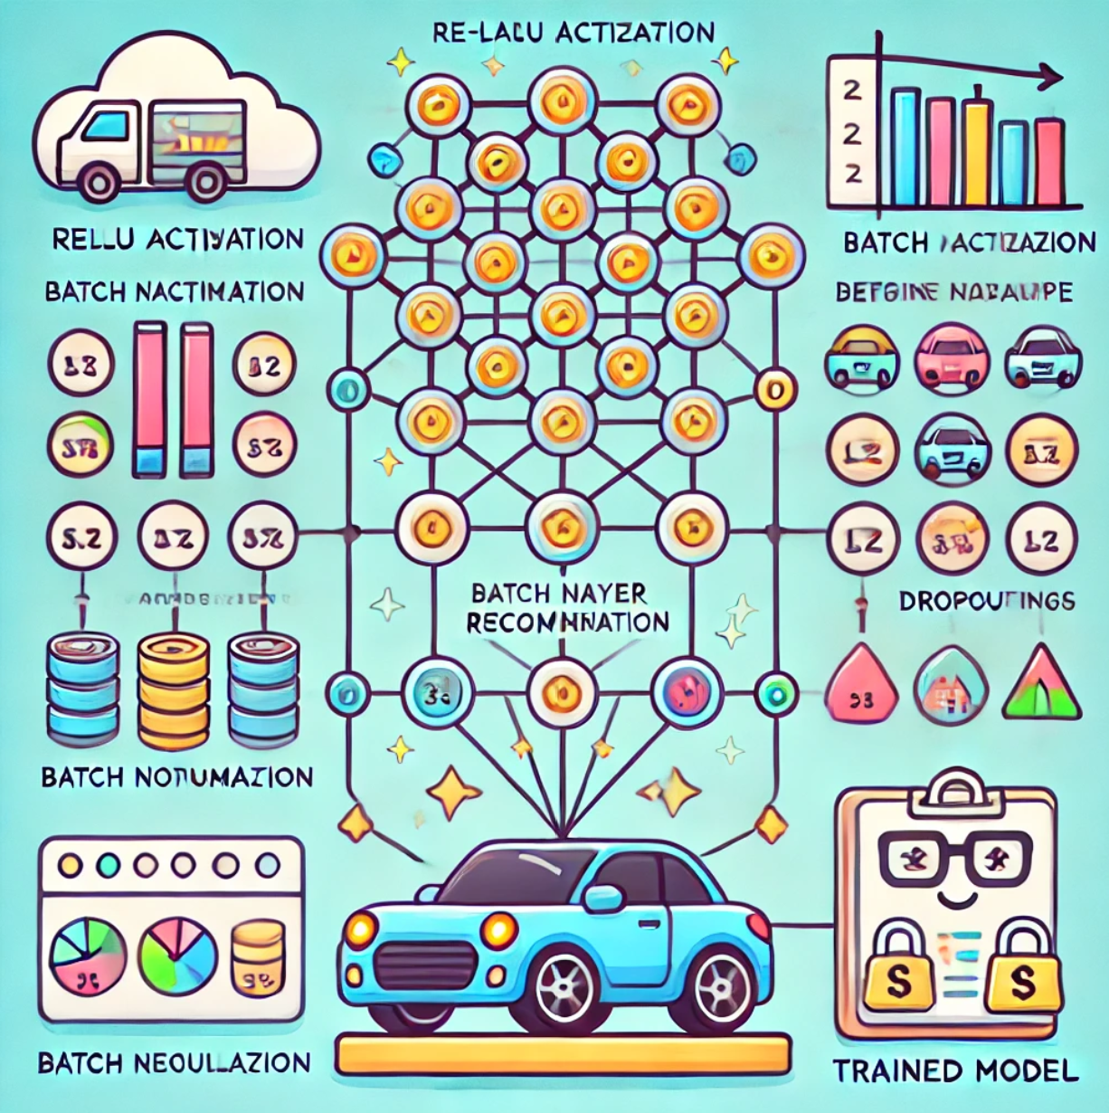
Neural Network Model
Model Overview
The neural network model for car recommendations processes 28 key features like price, engine type, and ratings to suggest the best car for users.
It uses a multi-layer architecture where each layer identifies complex relationships between features.
Key techniques include ReLU activation for non-linear learning, Batch Normalization to stabilize training, and Dropout to prevent overfitting.
Data scaling ensures all features are treated fairly, while L2 Regularization prevents the model from relying too heavily on specific attributes.
The output layer uses Softmax to assign probabilities to each car category. The model is trained using Cross-Validation for reliable performance and is optimized using RMSprop.
It measures accuracy through metrics like precision and recall, ensuring the model learns effectively without memorizing data. Once trained, the model is saved for future predictions, offering personalized car recommendations based on user preferences.

Slide 25
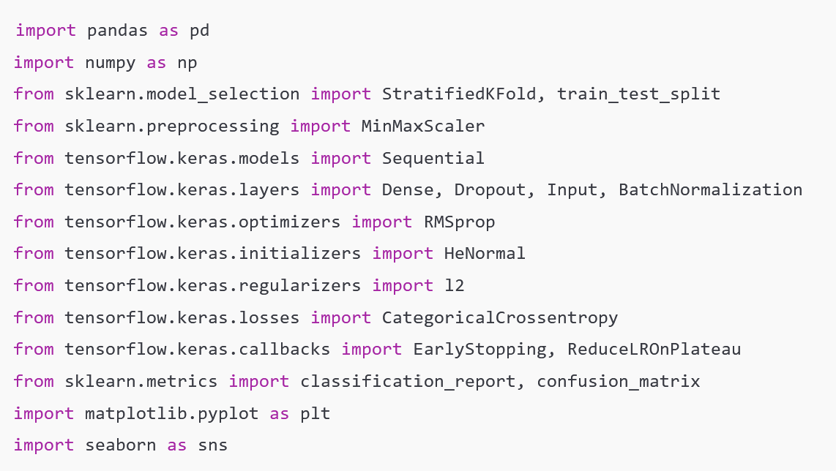
Library Imports :
pandas and NumPy: Help manage and analyze large datasets efficiently.
scikit-learn functions: Provide tools to split datasets, perform cross-validation, and scale data.
Keras functions: Used to define and train deep learning models with layers, optimizers, and loss functions.
Matplotlib and Seaborn: Create visualizations to help understand and interpret the training process and results.

Slide 26
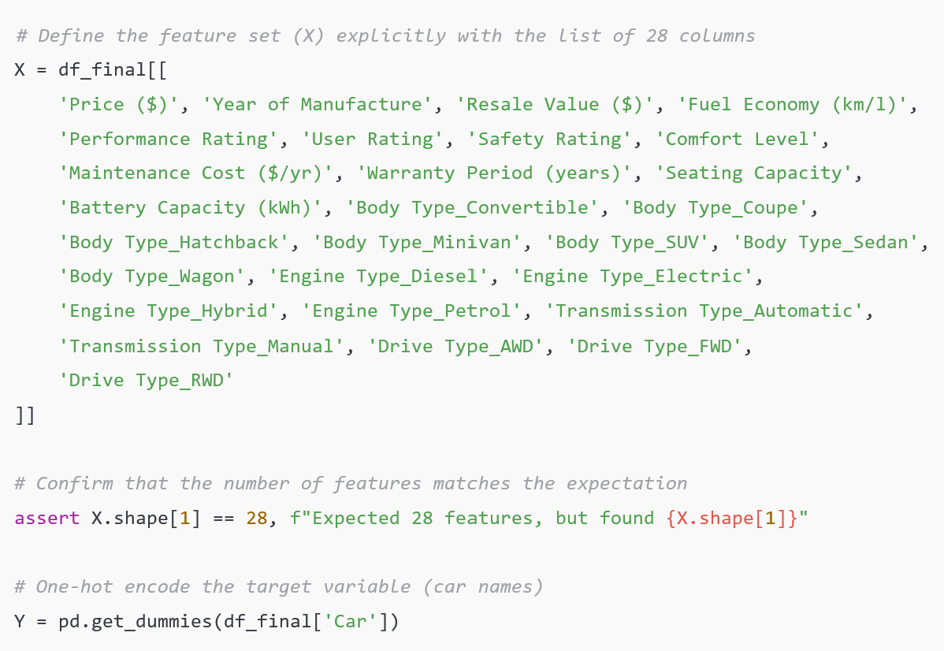
Defining Features and Target Variables
X contains the columns that represent characteristics of each car, such as price, ratings, fuel efficiency, etc. The code checks to ensure there are exactly 28 columns, which means each car is being described with 28 unique pieces of information.
Y is the target variable (in this case, the specific car being recommended). By one-hot encoding, the car names are transformed into a format the model can understand. Each car is represented as a unique vector (e.g., [0, 1, 0] for Car B in a group of three cars).

Slide 27
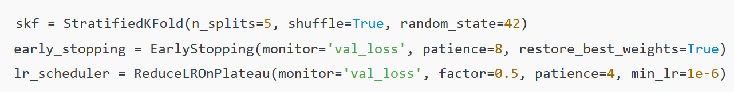
Cross-Validation and Callbacks
Cross-Validation (Stratified K-Fold) divides the dataset into five parts (or "folds") to validate the model's performance consistently. It ensures that each fold has a similar mix of different car categories, providing more reliable results.
Early Stopping is like setting an alarm to stop training if no improvement is detected in the model’s performance (measured by validation loss). This prevents the model from training endlessly and overfitting the data.
Learning Rate Scheduler: If the model’s performance doesn’t improve for a few rounds (epochs), this scheduler automatically reduces the speed (learning rate) at which the model learns, giving it more time to refine its learning.

Slide 28
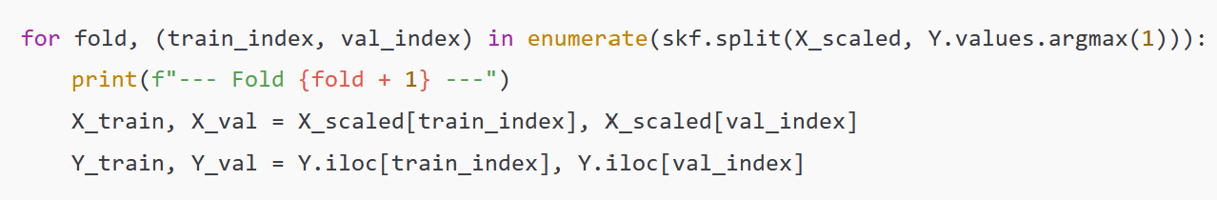
Cross-Validation Loop
This loop repeats the training process five times (one for each fold). Each time, the dataset is split into training data and validation data.
Training Data is what the model learns from.
Validation Data is a smaller set that helps measure how well the model is doing after each round of training. It’s like holding back some test questions to check if the student (model) is learning correctly.

Slide 29
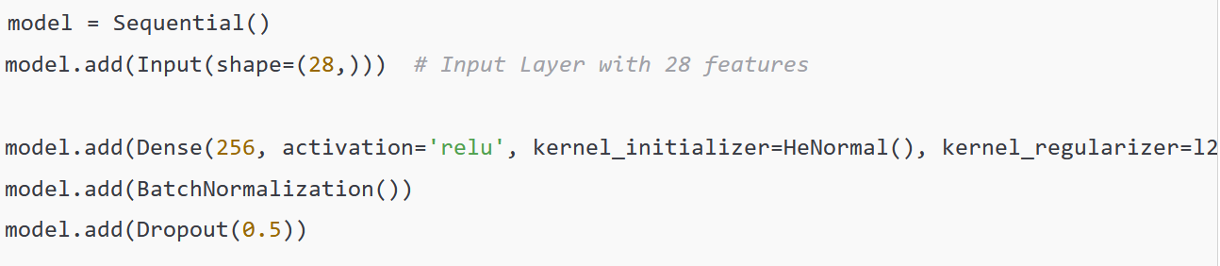
The Neural Network
It is a Sequential Model, meaning the layers are stacked in order, from input to output.
Input Layer: Takes 28 features (like engine type, safety rating, etc.).
First Hidden Layer: Contains 256 neurons, which process these features. Each neuron is a small decision-maker that looks at different parts of the car data.
ReLU Activation helps the model capture more complex relationships between features.
HeNormal Initialization sets the initial weights in a way that accelerates training.
L2 Regularization applies a penalty to the size of the weights, preventing overfitting.
Batch Normalization standardizes the output of this layer to improve training stability.
Dropout randomly "turns off" half the neurons during training, preventing the model from becoming too reliant on specific neurons (which reduces overfitting).

Slide 30
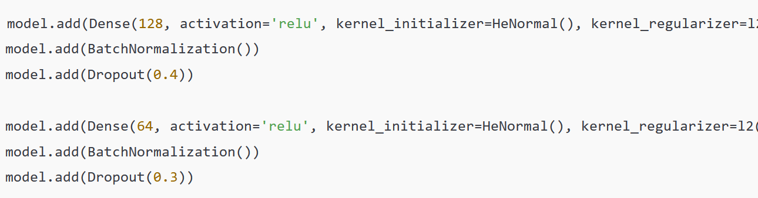
Additional Hidden layers
The model has additional hidden layers with progressively fewer neurons (128 and 64), each learning smaller details and features from the car data.
The reduced neuron count helps the model refine its learning step-by-step. By gradually narrowing down options when making a decision, these layers allow the model to focus on the most relevant features.
Dropout rates (40% and 30%) gradually decrease to help the model stabilize its learning.
Output Layer
The final layer uses a Softmax Activation function, which converts the model's output into probabilities for each car category. For example, if there are 10 different cars, Softmax assigns a probability to each one, indicating how confident the model is about each choice.

Slide 31
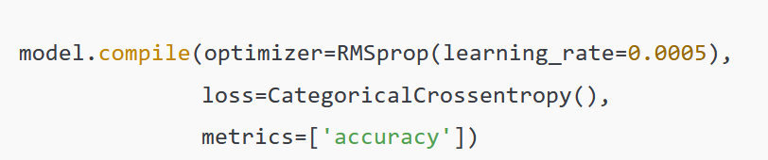
Compiling the Model
Compiling is like setting the rules and strategy for training the model.
Optimizer (RMSprop) adjusts the model's weights to minimize errors.
Loss Function (Categorical Cross-Entropy) measures the difference between the predicted and actual car categories. It tells the model how far off it is from the correct answer.
Accuracy Metric calculates how often the model's predictions match the actual car categories.

Slide 32
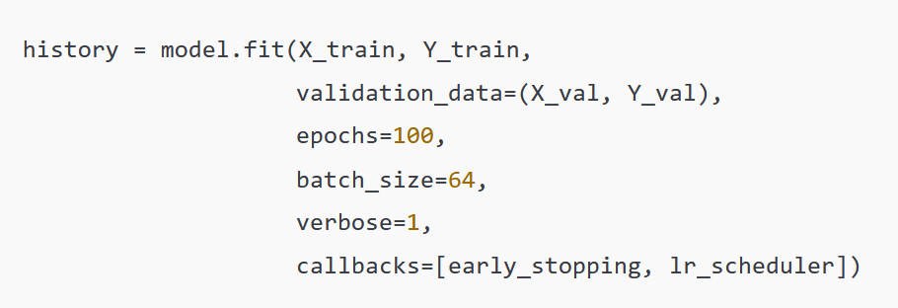
Training the model
Model Fit: This command starts the training process, where the model learns from the training data.
Validation Data: The model checks its progress against validation data to see how well it’s learning.
Epochs: Represents the number of times the entire dataset is processed. Each pass (epoch) helps the model learn a little better.
Batch Size: Determines how many samples the model processes at once. In this case, the model handles 64 samples at a time to optimize memory and speed.

Slide 33
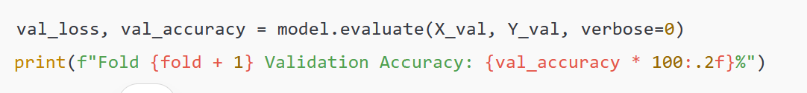
Evaluating Each Fold
After each round of training, the model was tested on the validation data to measure how well it learned. This line prints the percentage of correct predictions (validation accuracy) for each fold.
A total of 5 folds were created, with data visualization matplots drawn and displayed to thoroughly analyse the accuracy of training for the fold.

Slide 34
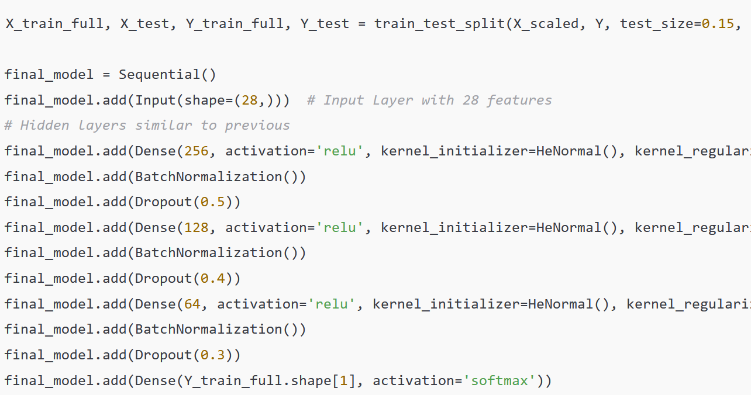
Final Model Split and Creation
The entire dataset was split into a larger training set (X_train_full, Y_train_full) and a smaller test set (X_test, Y_test). The test set was kept separate for evaluating the final performance of the trained model.
After defining the new training and test sets, a final model was built using the same layers and parameters as in the cross-validation loop. This ensures consistency in model design and allows the final model to leverage the complete dataset for training, except for the set-aside test data.

Slide 35
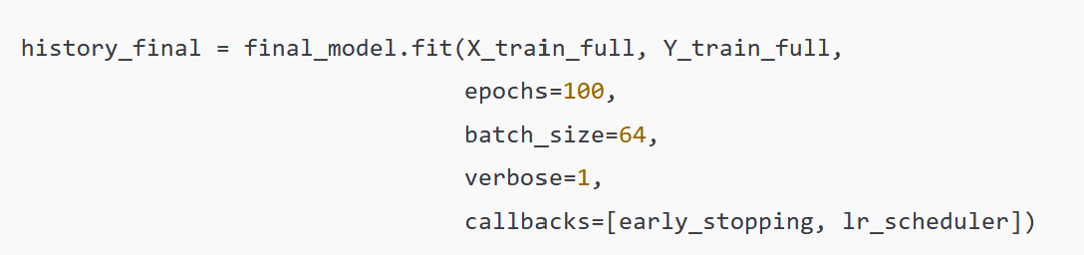
Training of the Final Model
The final model was now trained on the complete training set (X_train_full, Y_train_full). The same parameters (100 epochs, batch size of 64) and callbacks (early stopping and learning rate reduction) were applied to maintain the model’s performance and prevent overfitting.
Saving the Final Model
The final trained model was saved in the .keras format, allowing it to be reloaded and used for predictions later. Saving the model also preserved all the weights and configurations, enabling further fine-tuning if needed.

Slide 36
Challenges and issues Faced and how it was fixed
Addressing Overfitting During Model Training
Issue
During the training phase, the neural network model initially showed signs of overfitting. Overfitting occurs when the model becomes overly tailored to the training data, resulting in excellent performance on known data but poor accuracy on new, unseen data.
This issue was identified when the training accuracy remained consistently high while the validation accuracy either plateaued or showed a declining trend.
Resolution
To address this problem, Dropout layers were incorporated into the neural network. Dropout works by randomly deactivating a proportion of neurons during each training iteration, preventing the model from overly relying on specific neurons.
Additionally, L2 Regularization was applied to add a slight penalty to larger weights, encouraging the model to distribute its attention more evenly across all features.
These techniques collectively improved the model’s ability to generalize, thereby enhancing its performance on validation datasets as well as new datasets.

Slide 37
Evaluating Model Performance and Accuracy
Issue
Accurately assessing the model’s performance presented a unique challenge, especially in dealing with imbalanced classes and multiple car categories.
At first, there was a risk that the model would favor more common car categories while struggling to correctly predict less frequent ones, thereby compromising its overall effectiveness.
Resolution
To address this challenge, the technique of Stratified K-Fold Cross-Validation was implemented. This approach divides the data into multiple folds, ensuring that each fold maintains a balanced distribution of all car categories.
This method provided a more reliable and comprehensive evaluation of the model’s capabilities. Furthermore, a range of performance metrics was utilized, including Precision (indicating the percentage of correct predictions for each car type), Recall (measuring how well the model identified actual car types), and F1-Score (which balances precision and recall).
These metrics offered a detailed assessment of the model’s classification performance across all categories, ensuring that both common and less frequent car types were accurately represented.

Slide 38
Ensuring Correct Data Ordering for Model Input
Issue
One critical challenge encountered during development was ensuring that the cleaned data had its features in the exact order required by the neural network model. The model expected the input features—such as normalized numerical values (like price or ratings) and one-hot encoded categorical values (like body type or engine type)—to be arranged in a specific sequence. However, the questions in the web application were initially collected in a different order, leading to a mismatch between the way the model expected data and the actual order of the collected inputs.
This mismatch resulted in the wrong values being fed into the wrong fields within the model. For example, the feature meant to represent "body type" was being fed into a field representing "engine type," which initially led to distorted predictions and reduced model accuracy.
Resolution
The solution involved rearranging the questions in the application to match the exact order required by the neural network. After collecting user responses, an additional step was introduced to reorder the collected data to precisely align with the model’s expected feature sequence. This involved creating a mapping that linked each collected user input to the appropriate feature column. By performing these checks and reordering steps, the issue of feeding incorrect data into the model’s fields was resolved, ensuring that each feature aligned perfectly with the model’s structure and produced accurate predictions.

Slide 39
Improvements made on feedback received
The project underwent two major improvements based on feedback and suggestions given
by our tutor Dr. Xinyi Cai.
Early Stopping and Epoch Reduction
The training process initially ran for an excessive number of epochs ( 175 ), leading to unnecessary computation and potential overfitting.
Based on feedback, the number of epochs was reduced ( 100 ), and an Early Stopping mechanism was introduced to automatically halt training once the model’s loss stabilized.
This optimization reduced computation time and improved model efficiency.
UI Enhancement with Clickable Buttons
Initially, the app relied on dropdowns and sliders, which were functional but lacked visual appeal. Based on feedback to make the app more engaging, the design was updated to include clickable image-based buttons.
This change not only improved interactivity but also provided a more intuitive experience for users.

Slide 40
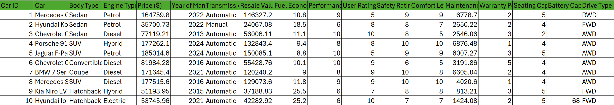
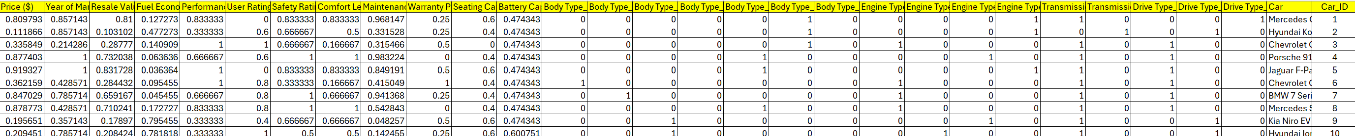
Final Product testing and usage
Data set Cleaning and Processing
Raw data
Cleaned , Proccessed and Prepared data

Slide 41
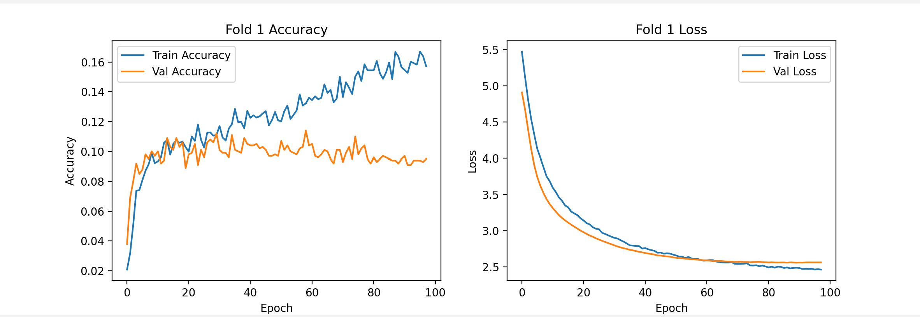
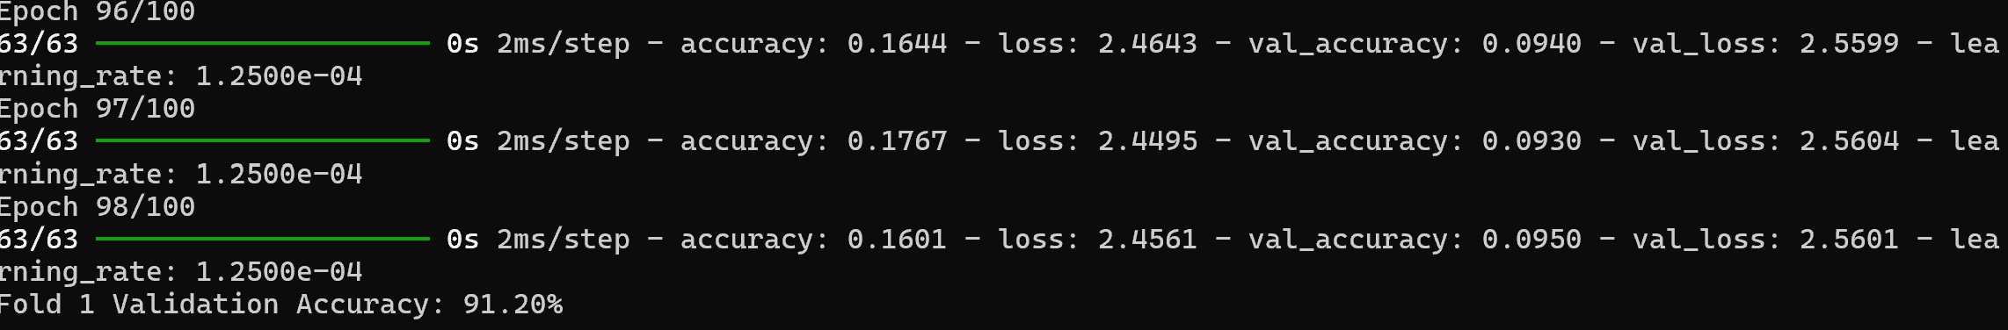
Trained Neural Network Accuracy
Training accuracy and Fold loss reduction after completion of the training of the 1st fold of dataset

Slide 42
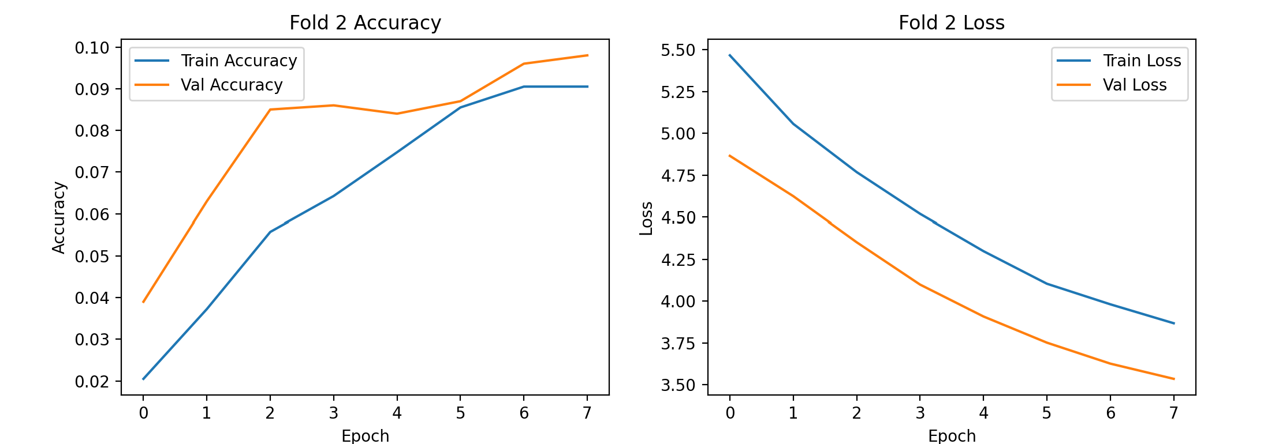
Training accuracy and Fold loss reduction after completion of the training of the 2nd fold of dataset

Slide 43
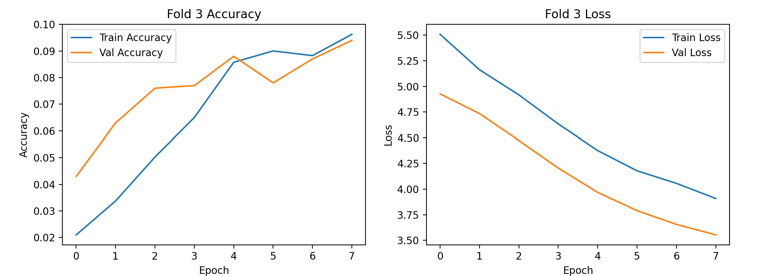
Training accuracy and Fold loss reduction after completion of the training of the 3rd fold of dataset

Slide 44
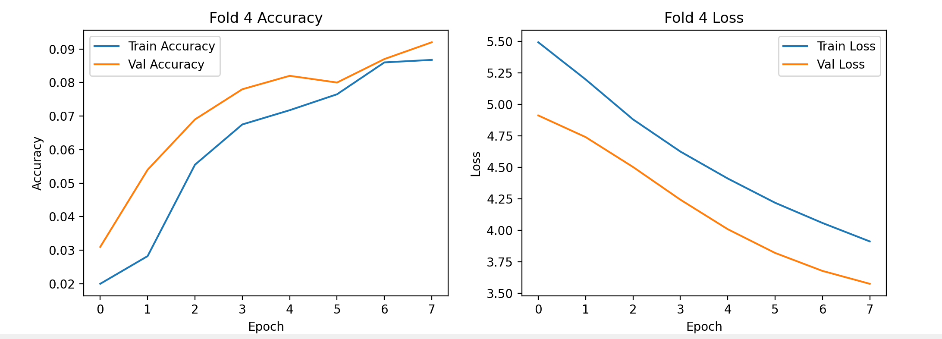
Training accuracy and Fold loss reduction after completion of the training of the 4th fold of dataset

Slide 45
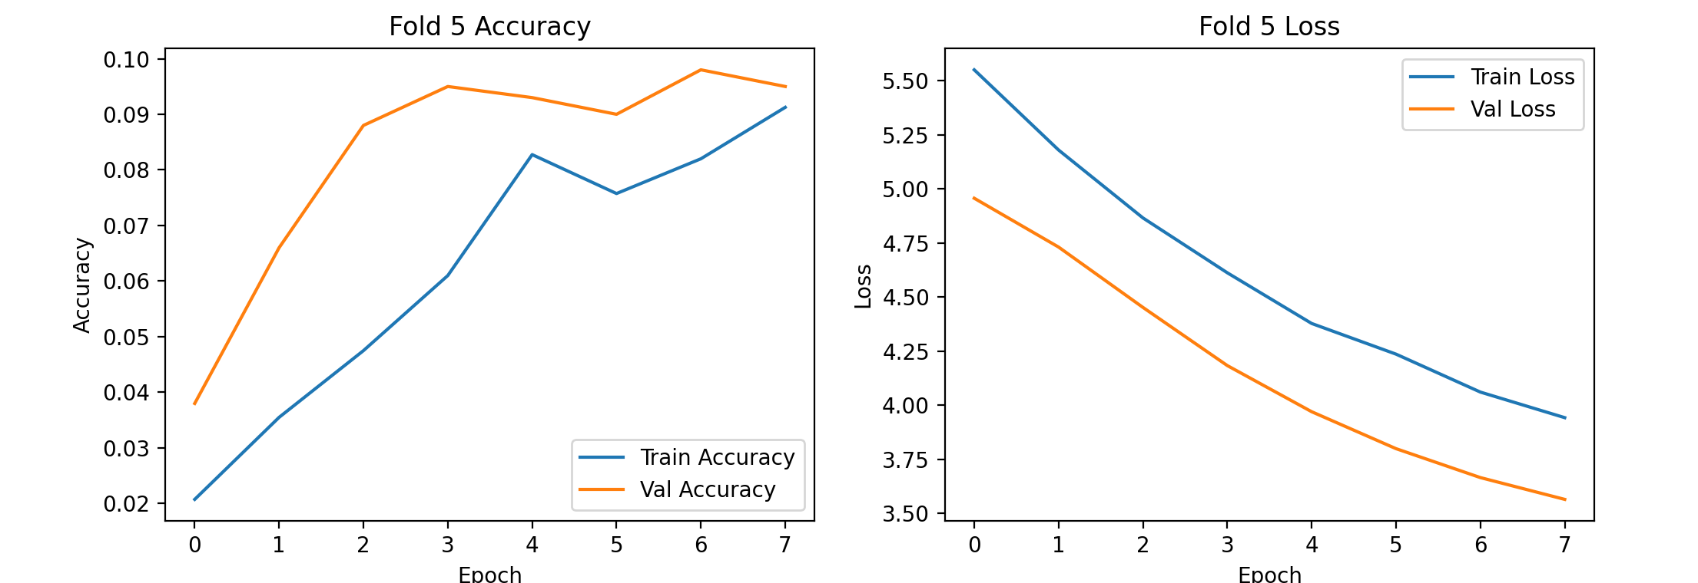
Training accuracy and Fold loss reduction after completion of the training of the 5th fold of dataset

Slide 46
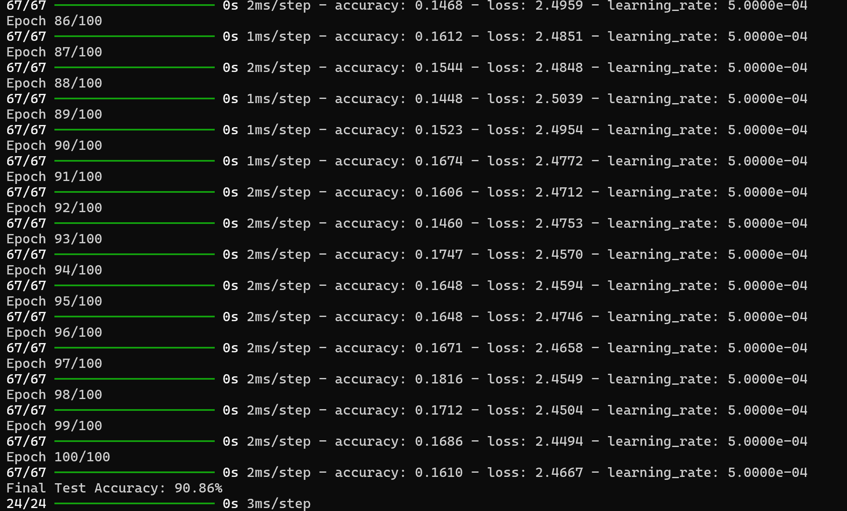
Trained Neural Network Accuracy
The neural network model achieved a final test accuracy of 90.86 %.

Slide 47

Personalized Car Recommendation - tests and results
Real life Testing of the system
User 1 - Mr. Jason Andrewartha ( performance , brand value and safety focused user )
Jason says “Hi , I want a powerful diesel SUV that has a good brand name , good warranty and reliability . It should not be more than 3 years old and should strictly be a front wheel drive car”.
Jason’s personalized choices were chosen as selections for the model and the below car was recommended by the model .
Jason was really impressed with the recommended model.

Slide 48

User 2 - Mr. Philip Henderson ( Budget focused family oriented user looking for efficiency)
Philip says, "I'm looking for an efficient and reliable family car with great fuel economy and a spacious interior. It should come with a good warranty, be within my budget, and should be a front-wheel drive for better fuel efficiency."
Philip's personalized choices were selected for the model, and the car recommendation provided by the model met all his preferences. Philip was very satisfied with the recommended vehicle, appreciating its balance of affordability, efficiency, and reliability.

Slide 49

User 3 - Mr. Ronald Stevens (Comfort-focused user looking for a powerful yet cost-efficient SUV)
Ronald says, "I'm looking for a mid-size diesel SUV that is powerful but not too expensive to own and maintain. It should be spacious enough for 6 people and comfortable for long highway drives."
Ronald's personalized choices were selected for the model, and the recommended SUV matched his criteria perfectly. He was pleased with the balance of power, spacious interior, and overall comfort of the recommended vehicle, making it an ideal choice for both family trips and long drives.

Slide 50
User 4 - Ms. Elena Vasquez (Eco-conscious city dweller looking for a stylish, eco-friendly electric car)
Elena says, "I want a compact, eco-friendly electric or a hybrid car that's easy to maneuver in the city. It should have good mileage, a sleek design, and modern features like parking assistance. Sustainability is important to me, but I also want it to look stylish and minimalist."
Elena's personalized choices were selected for the model, and the recommended electric car fit her vision perfectly. She was thrilled with the stylish design, zero-emission engine, and advanced city-driving features of the recommended vehicle, making it the ideal choice for sustainable urban commuting.

Slide 51

Future scope and plans for Expansion
The Car Purchase Recommendation System is currently a web-based application running locally for development and testing purposes. However, there are several ways to scale and extend its capabilities to reach a wider audience.

Slide 52

Scaling, Dockerization, and Global Access
At present, the system operates in a local environment.
To prepare it for worldwide usage, the app can be scaled and containerized using Docker.
Docker packages the entire application, including its dependencies, so that it can work consistently on different machines and environments.
Once containerized, the system can be deployed on cloud platforms like AWS, Google Cloud, or Azure to enable global accessibility.
This means people from any part of the world can easily access the app.
Additionally, using tools like Kubernetes would help manage and scale the app automatically, making sure it performs efficiently even with high user traffic.

Slide 53

Integration as an API or with Partner Platforms
Beyond its current form as a web application, the recommendation system could also be offered as a standalone API.
This means that other developers and businesses could integrate the recommendation features directly into their own platforms.
For example, well-known automotive sites like CarWow, Cars24.com, or Autocar.com could use this system to enhance their existing platforms with smart, AI-driven car recommendations.
Additionally, the app could be utilized internally by car sales agents or automotive review websites to offer personalized suggestions to customers, making it a valuable tool in their sales process.

Slide 54

Building a Native Mobile App
While the system is currently web-based, it could be transformed into a native mobile app using the same recommendation model.
A mobile version would allow users to access the app directly from their smartphones or tablets, making it more convenient for people on the go.
The mobile app could also take advantage of features like geolocation to recommend nearby car dealerships or showcase location-based deals, further improving the user experience.

Slide 55
Conclusion
In a nutshell, the Car Purchase Recommendation System successfully fulfills its primary goal of providing personalized car recommendations to users based on their unique preferences. By leveraging an interactive front-end built with Streamlit and an advanced neural network on the back-end, the system achieves both technical excellence and user engagement. The streamlined user interface features interactive questions paired with image-based options, enhancing user involvement in the recommendation process.
Technically, key advancements such as early stopping during model training and meticulous UI enhancements have significantly improved the system’s predictive accuracy and user satisfaction. The project's achievements reflect a cohesive blend of machine learning insights and usability principles.
Looking forward, the system presents promising expansion opportunities. It can be containerized using Docker and deployed on cloud platforms to reach a global audience. Furthermore, offering the system as a standalone API can enable integration with leading car sales platforms or internal use by sales agents. Moreover, the development of a native mobile application would further increase accessibility and user convenience.
In all, this project represents a synergy of AI-driven recommendations with an intuitive, interactive design, setting the stage for a more efficient, enjoyable, and tailored car-buying journey.

Slide 56
References
[1] E. Alpaydin, Introduction to Machine Learning, 4th ed. Cambridge, MA: MIT Press, 2020.
[2] Y. Bengio and Y. LeCun, "Generalization in deep learning," Journal of Machine Learning Research, vol. X, pp. xxx-xxx, 2003.
[3] C. M. Bishop, Pattern Recognition and Machine Learning. New York, NY: Springer, 2006.
[4] F. Chollet, Deep Learning with Python. Shelter Island, NY: Manning Publications, 2017.
[5] I. Goodfellow, Y. Bengio, and A. Courville, Deep Learning. Cambridge, MA: MIT Press, 2016.
[6] D. P. Agrawal and S. P. Pandey, Data Science and Big Data Analytics: Data Collection, Processing, Cleaning, and Visualization. New York, NY: Springer, 2021.
[7] K. P. Murphy, Machine Learning: A Probabilistic Perspective. Cambridge, MA: MIT Press, 2012.
[8] M. A. Nielsen, Neural Networks and Deep Learning: A Textbook. Determination Press, 2015.
[9] M. R. Berthold, C. Borgelt, F. Höppner, and F. Klawonn, Guide to Intelligent Data Analysis: How to Intelligently Make Sense of Real Data. London, U.K.: Springer, 2019.
[10] I. Sutskever, J. Martens, and G. Hinton, "Learning with recurrent neural networks," in Proceedings of the 28th International Conference on Machine Learning, pp. xxx-xxx, 2011.
[11] C. Zhang and Y. Ma, Ensemble Machine Learning: Methods and Applications. New York, NY: Springer, 2021.
[12] J. A. Smith and R. B. Doe, "Developing interactive web applications using Streamlit: A case study," Journal of Web Technology, vol. 15, no. 3, pp. 234-250, 2021.
[13] www.https://stackoverflow.com/
[14] www.https://w3schools.com/

